Slide 1
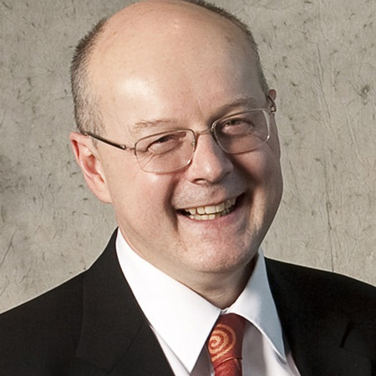
Nanomedicines Innovation Network (NMIN)
$18,532,000
6 years (2019-2025)
A Government of Canada
Networks of Centres of Excellence (NCE)
NMIN’s mission:
to develop novel therapeutics to cure high-burden human diseases and new diagnostics to detect disease more precisely
to commercialize these products to bring health and economic benefits to Canadians; and
to train the skilled workforce required by the growing nanomedicines industry
Research Themes:
Targeted Drug Delivery
Gene Therapy
Diagnostics
Core Facilities:
NanoCore: NanoMedicines Formulation and Characterization
PharmaCore: Pharmacology, Toxicology and Scaled Production
Dr. Pieter Cullis
Scientific Director & CEO
Dr. Gilbert Walker
Associate Scientific Director
nanomedicines.ca | info@nanomedicines.ca | @NMIN_NCE

