Slide 1
NanoMedicines Innovation Network (NMIN)
Talk Title
12 July 2022 | 9:00 – 11:30 am
Location of presentation
Presentation to the X group
Dr. Diana Royce
Executive Director

Slide 2
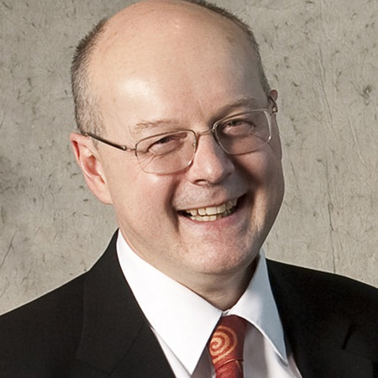
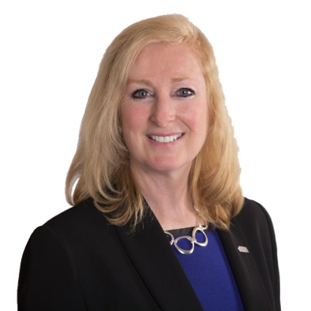
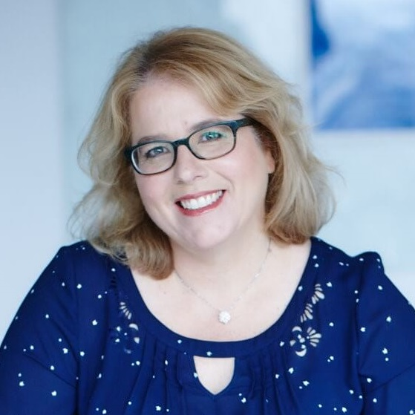
NanoMedicines Innovation Network (NMIN)
$19,125,000
5 years (2019-2024)
funded by the Government of Canada through
the Networks of Centres of Excellence (NCE) Program
Dr. Gilbert Walker
Interim Scientific Director
Dr. Diana Royce
Executive Director
Dr. Inès Holzbaur
Board Chair

Slide 3
The Nanomedicines Innovation Network (NMIN)
NCE Overarching Program Goal:
To mobilize Canada's research talent in the academic, private, public, and not-for-profit sectors and apply it to develop the Canadian economy and quality of life by supporting large-scale academically led research networks that harness the creativity and inventiveness of Canadian scientists to find solutions to major social, economic or health issues.
5 Mandate areas: 1) Excellence of the Research Program; 2) Development of Highly Qualified Personnel (HQP); 3) Networking & Partnerships; 4) Knowledge & Technology Exchange & Exploitation (KTEE); and 5) Management of the Network

Slide 4
The Nanomedicines Innovation Network (NMIN)
NMIN’s vision:
to establish and mobilize a national research and development network with participants drawn from academia, industry, and not-for-profit research enterprises, whose collective research, capacity building and commercialization efforts strengthen Canada’s position as a global leader in developing next generation nanomedicines, new Canadian companies and jobs
NMIN’s mission:
to develop novel therapeutics to cure high-burden human diseases and new diagnostics to detect disease more precisely
to commercialize these products to bring health and economic benefits to Canadians; and
to train the skilled workforce required by the growing nanomedicines industry

Slide 5
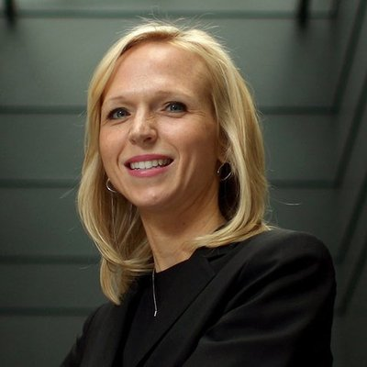
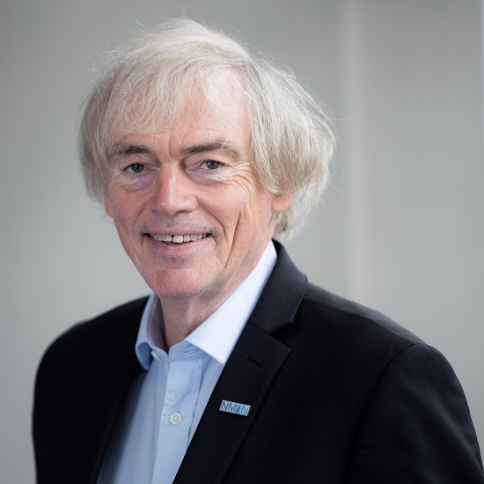
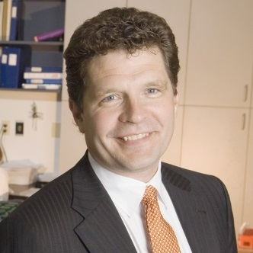
NMIN Leadership
Scientific Directors
Founding Scientific Director
2019-2021
Pieter Cullis
Biochemistry & Molecular Biology, UBC
Scientific Director
2021-2022
Interim Scientific Director
2022-present
Christine Allen
VP, Ecosystem Development, adMare Bioinnovations; UofT
Gilbert Walker
Chemistry, University of Toronto
Co-Founder of ~11 start-ups including: Canadian Liposome Company, Inex Pharmaceuticals (now Arbutus Biopharma), Northern Lipids Inc. (now Evonik Canada), Acuitas Therapeutics, Precision NanoSystems, Molecular You & NanoVation Therapeutics.
Recent honours for contributions to mRNA vaccine technology:
2022 Global Impact Award, BC Life Sciences
2022 Tang Prize (Taiwan)
2022 Gairdner International Award
2022 Governor General’s Innovation Award
2022 Lipid Science Prize
VinFuture Grand Prize (Vietnam)
2021 Prince Mahidol Prize (Thailand)
Featured in The Lancet, The New York Times, Nature, Nature . Review Materials & many other media outlets
Board Chairs
Inaugural Board Chair
2019-2022
Current Board Chair
2022-present
Don M. Enns
Former Head of Global Drug Delivery, Evonik Health Care
Inès Holzbaur
Co-Founder & Managing Partner, AmorChem

Slide 6
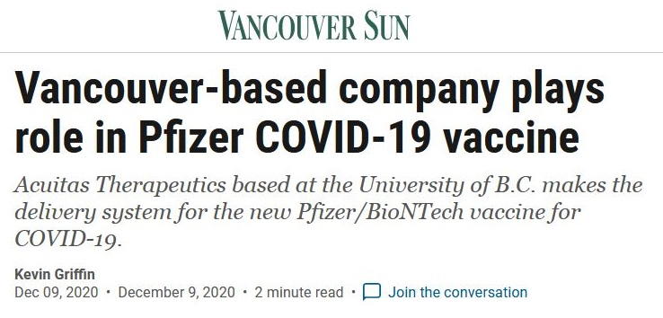
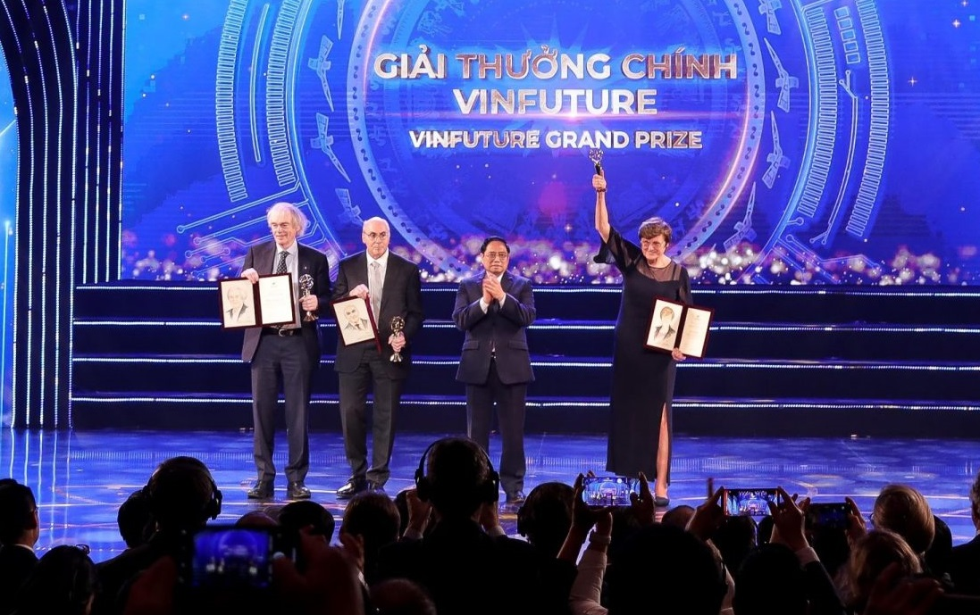
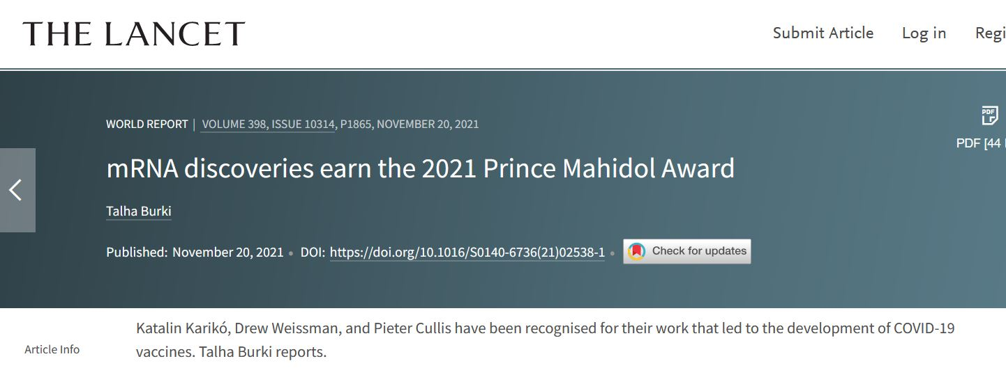
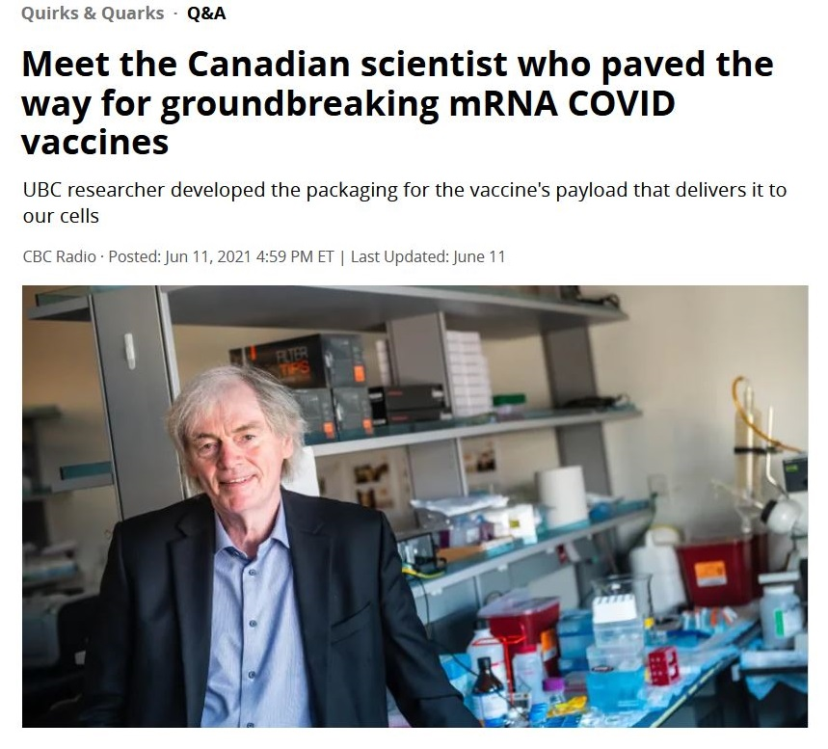
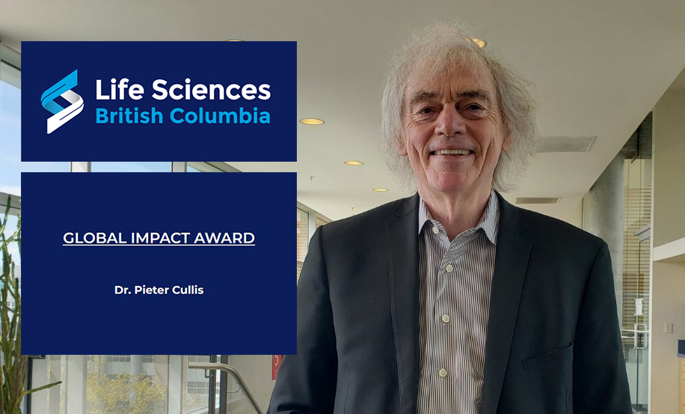
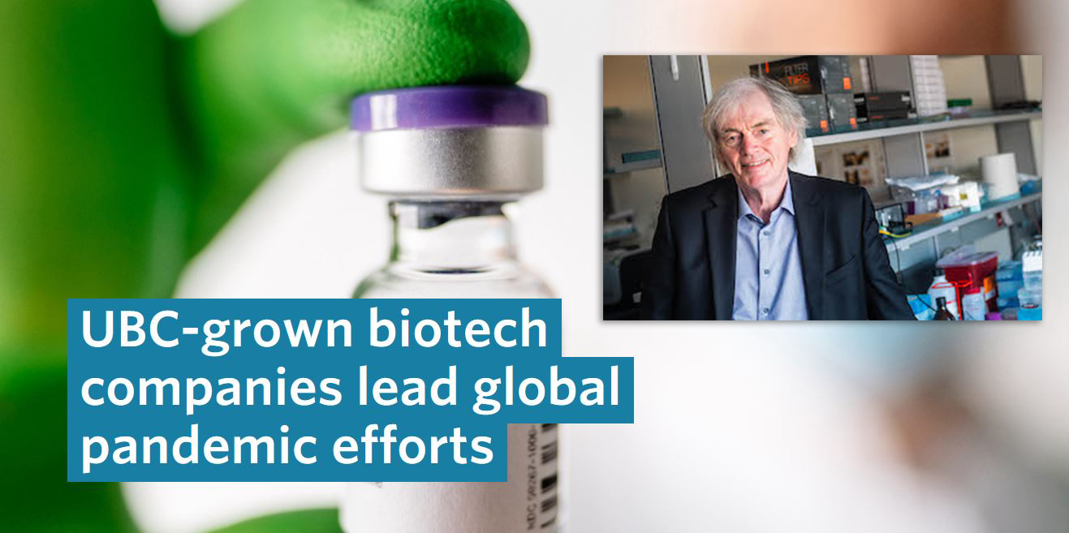
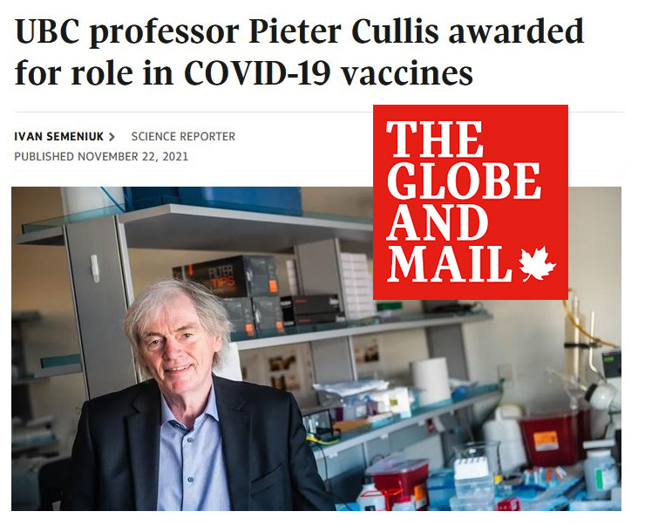
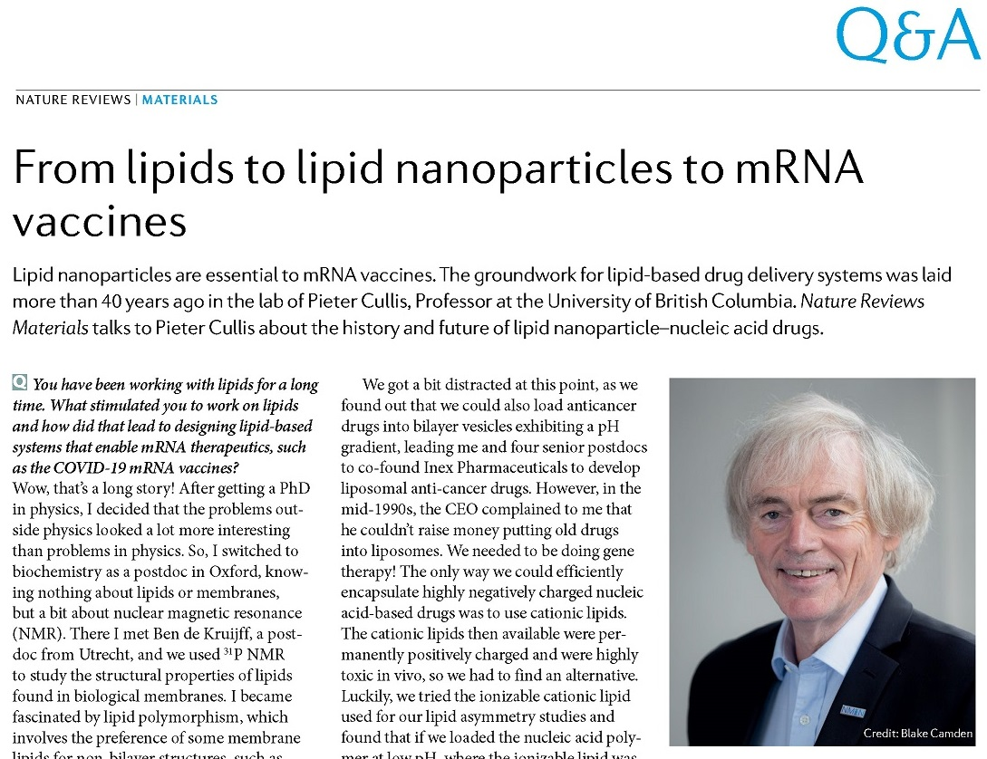
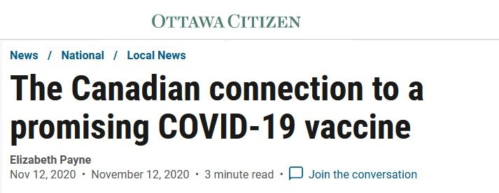
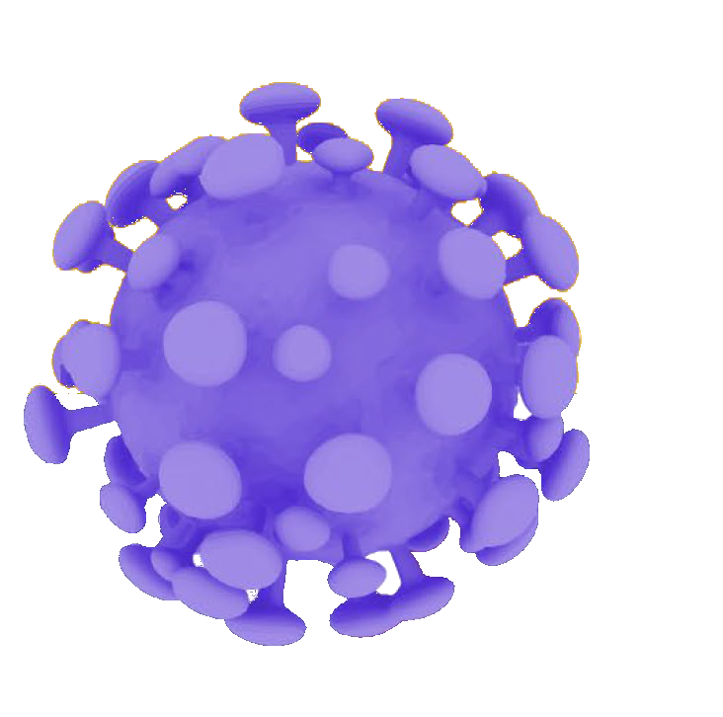
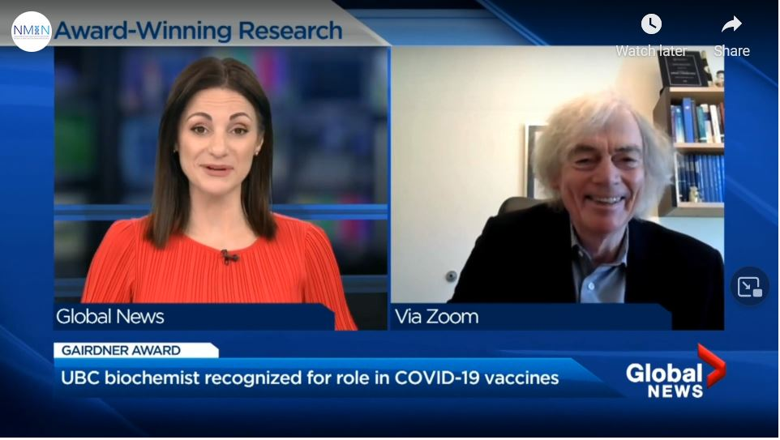
Notes:
Over the past year nanomedicines generally – and Canadian nanomedicine scientists and biotech companies specifically – have been catapulted into the public eye and gained immense recognition for their contributions to the development of effective COVID-19 vaccines.
High among these contributions were those of NMIN’s Founding Scientific Director, Dr. Pieter Cullis, whose 40 years of work with his UBC colleagues and others around the world led to the lipid nanoparticle delivery system that made Pfizer’s mRNA vaccine so effective.

Slide 7
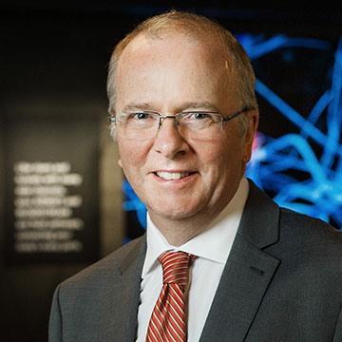
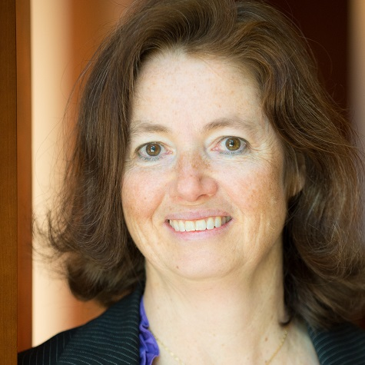
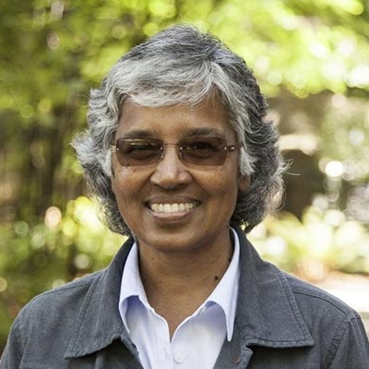
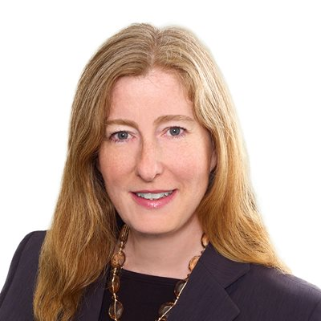
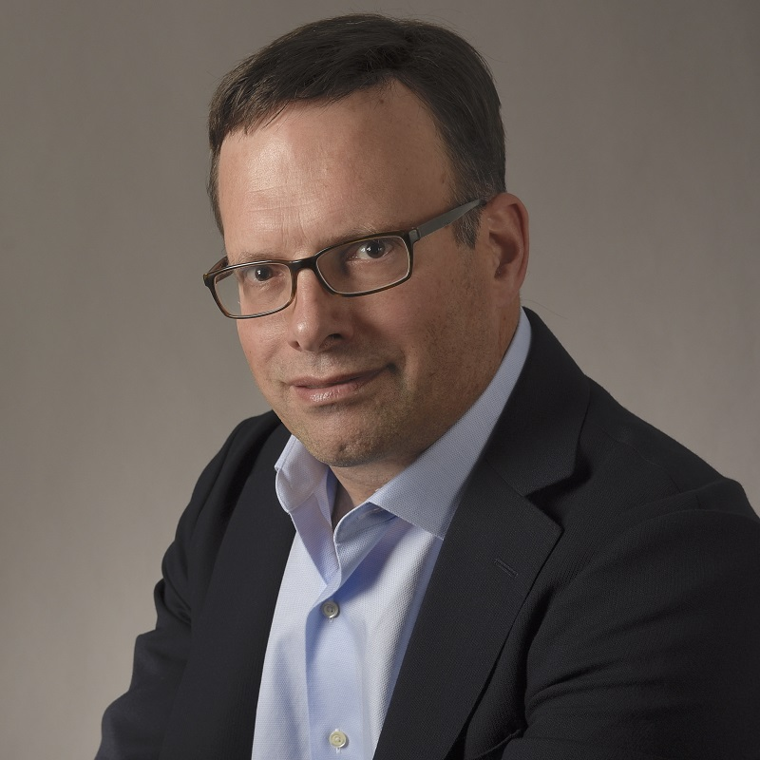
The Nanomedicines Innovation Network (NMIN)
Board of Directors
Board Chair
Michael Coughtrie
Professor & Dean, Faculty of Pharmaceutical Sciences, UBC
Pieter Cullis
Professor, Dept of Biochemistry & Molecular Biology, UBC
Lesley Esford
Board Vice-Chair; Director, Innovate BC
Rachel Fernandez
AVP Research & Innovation, University of British Columbia
Inès Holzbaur
Co-Founder & Managing Partner, AmorChem
Vanessa Grant
Partner, Norton Rose Fulbright Canada LLP
David Martin
Managing Director & Head of Equity Research, Bloom Burton Securities
Gilbert Walker
Chemistry, University of Toronto

Slide 8
The Nanomedicines Innovation Network (NMIN)
NMIN invests in proof-of-concept (PoC) and proof-of-principle (PoP) projects aimed at developing new therapeutics and diagnostics, the majority partnered with industry.
Current investments:
34 projects & 3 Core Facilities
104 researchers 27 PIs
10 institutions across Canada
99 partners (43 industry;
28 international in 11 countries)
The 34 projects & 3 Core Facilities in NMIN’s research portfolio span 10 member institutions across 5 provinces
AB: University of Alberta
BC: The University of British Columbia, University of Victoria
ON: University of Toronto, University Health Network, Queen’s University, U Waterloo
QC: Polytechnique Montréal, Université Laval
SK: University of Saskatchewan
AB: University of Alberta
BC: 1) The University of British Columbia, 2) University of Victoria
ON: 1) University of Toronto, 2) University Health Network, 3) Queen’s University, 4) U. Waterloo
QC: 1) Polytechnique Montréal, 2) Université Laval
SK: University of Saskatchewan

Slide 9
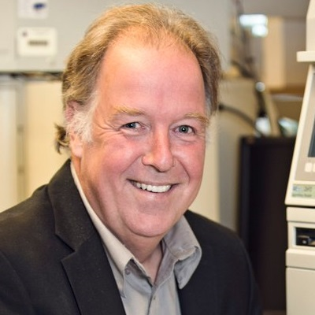
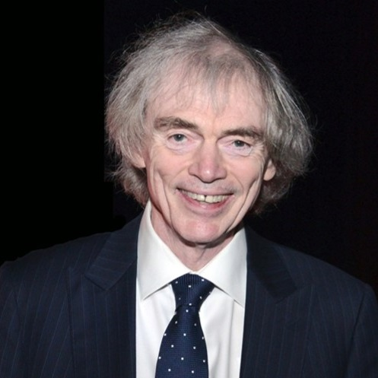
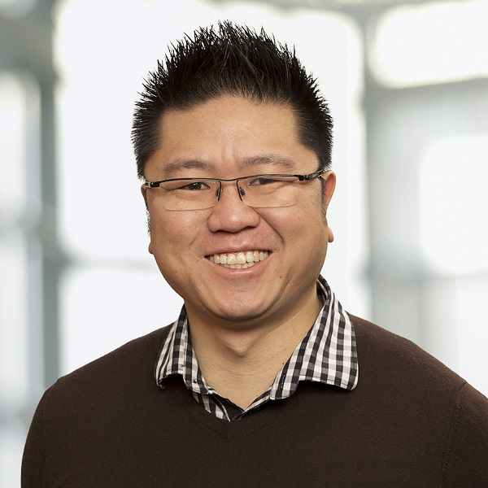
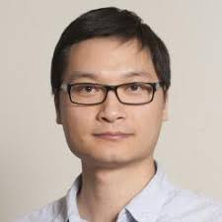
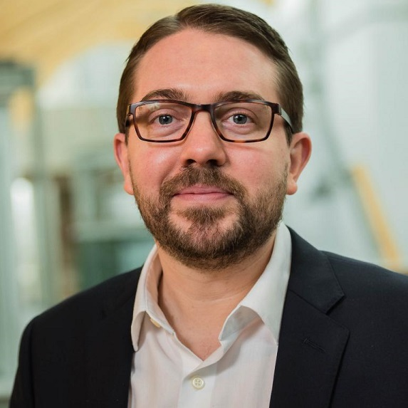
NMIN Research Themes & Research Leaders
Targeted Drug Delivery
Nanomedicines that deliver small molecule drugs more accurately to disease sites, dramatically enhancing the therapeutic properties of small molecule drugs.
Gene Therapy
Nanomedicines that enable big molecules, particularly nucleic acid-based drugs, to be used therapeutically, enabling gene therapies to treat most diseases.
Diagnostics
Nanotechnologies to detect disease earlier and more accurately, improving preventive healthcare and enabling precision medicine.
Theme 1 Leaders
Theme 2 Leaders
Theme 3 Leaders
Marcel Bally
PharmaCore Leader
Professor, Pathology & Laboratory Medicine, UBC
Pieter Cullis
NanoCore Leader
Professor, Biochemistry & Molecular Biology, UBC
Warren Chan
Professor, Institute for Biomedical Engineering, University of Toronto
TARGETED DRUG DELIVERY
DIAGNOSTICS
GENE THERAPY
Shyh-Dar Li
Associate Professor, Pharmaceutical Sciences, UBC
Christian Kastrup
NanoCore Co-Leader
Associate Professor, Michael Smith Laboratories, UBC & Versiti Blood Research Institute, WI, USA
Gilbert Walker
Professor, Department of Chemistry, University of Toronto

Slide 10
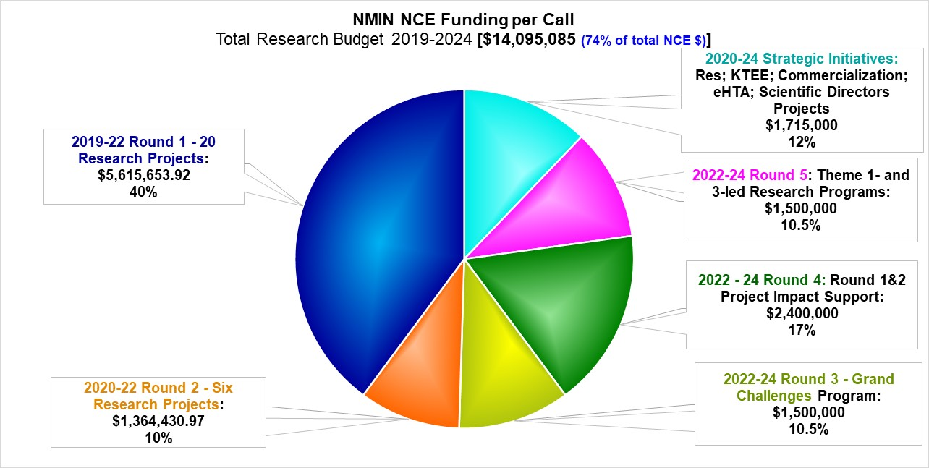
NMIN NCE Funding BUDGETED per Call:
Total Research Budget 2019-2024 ($14,095,085 = 74% of total NCE $19.1M)

Slide 11
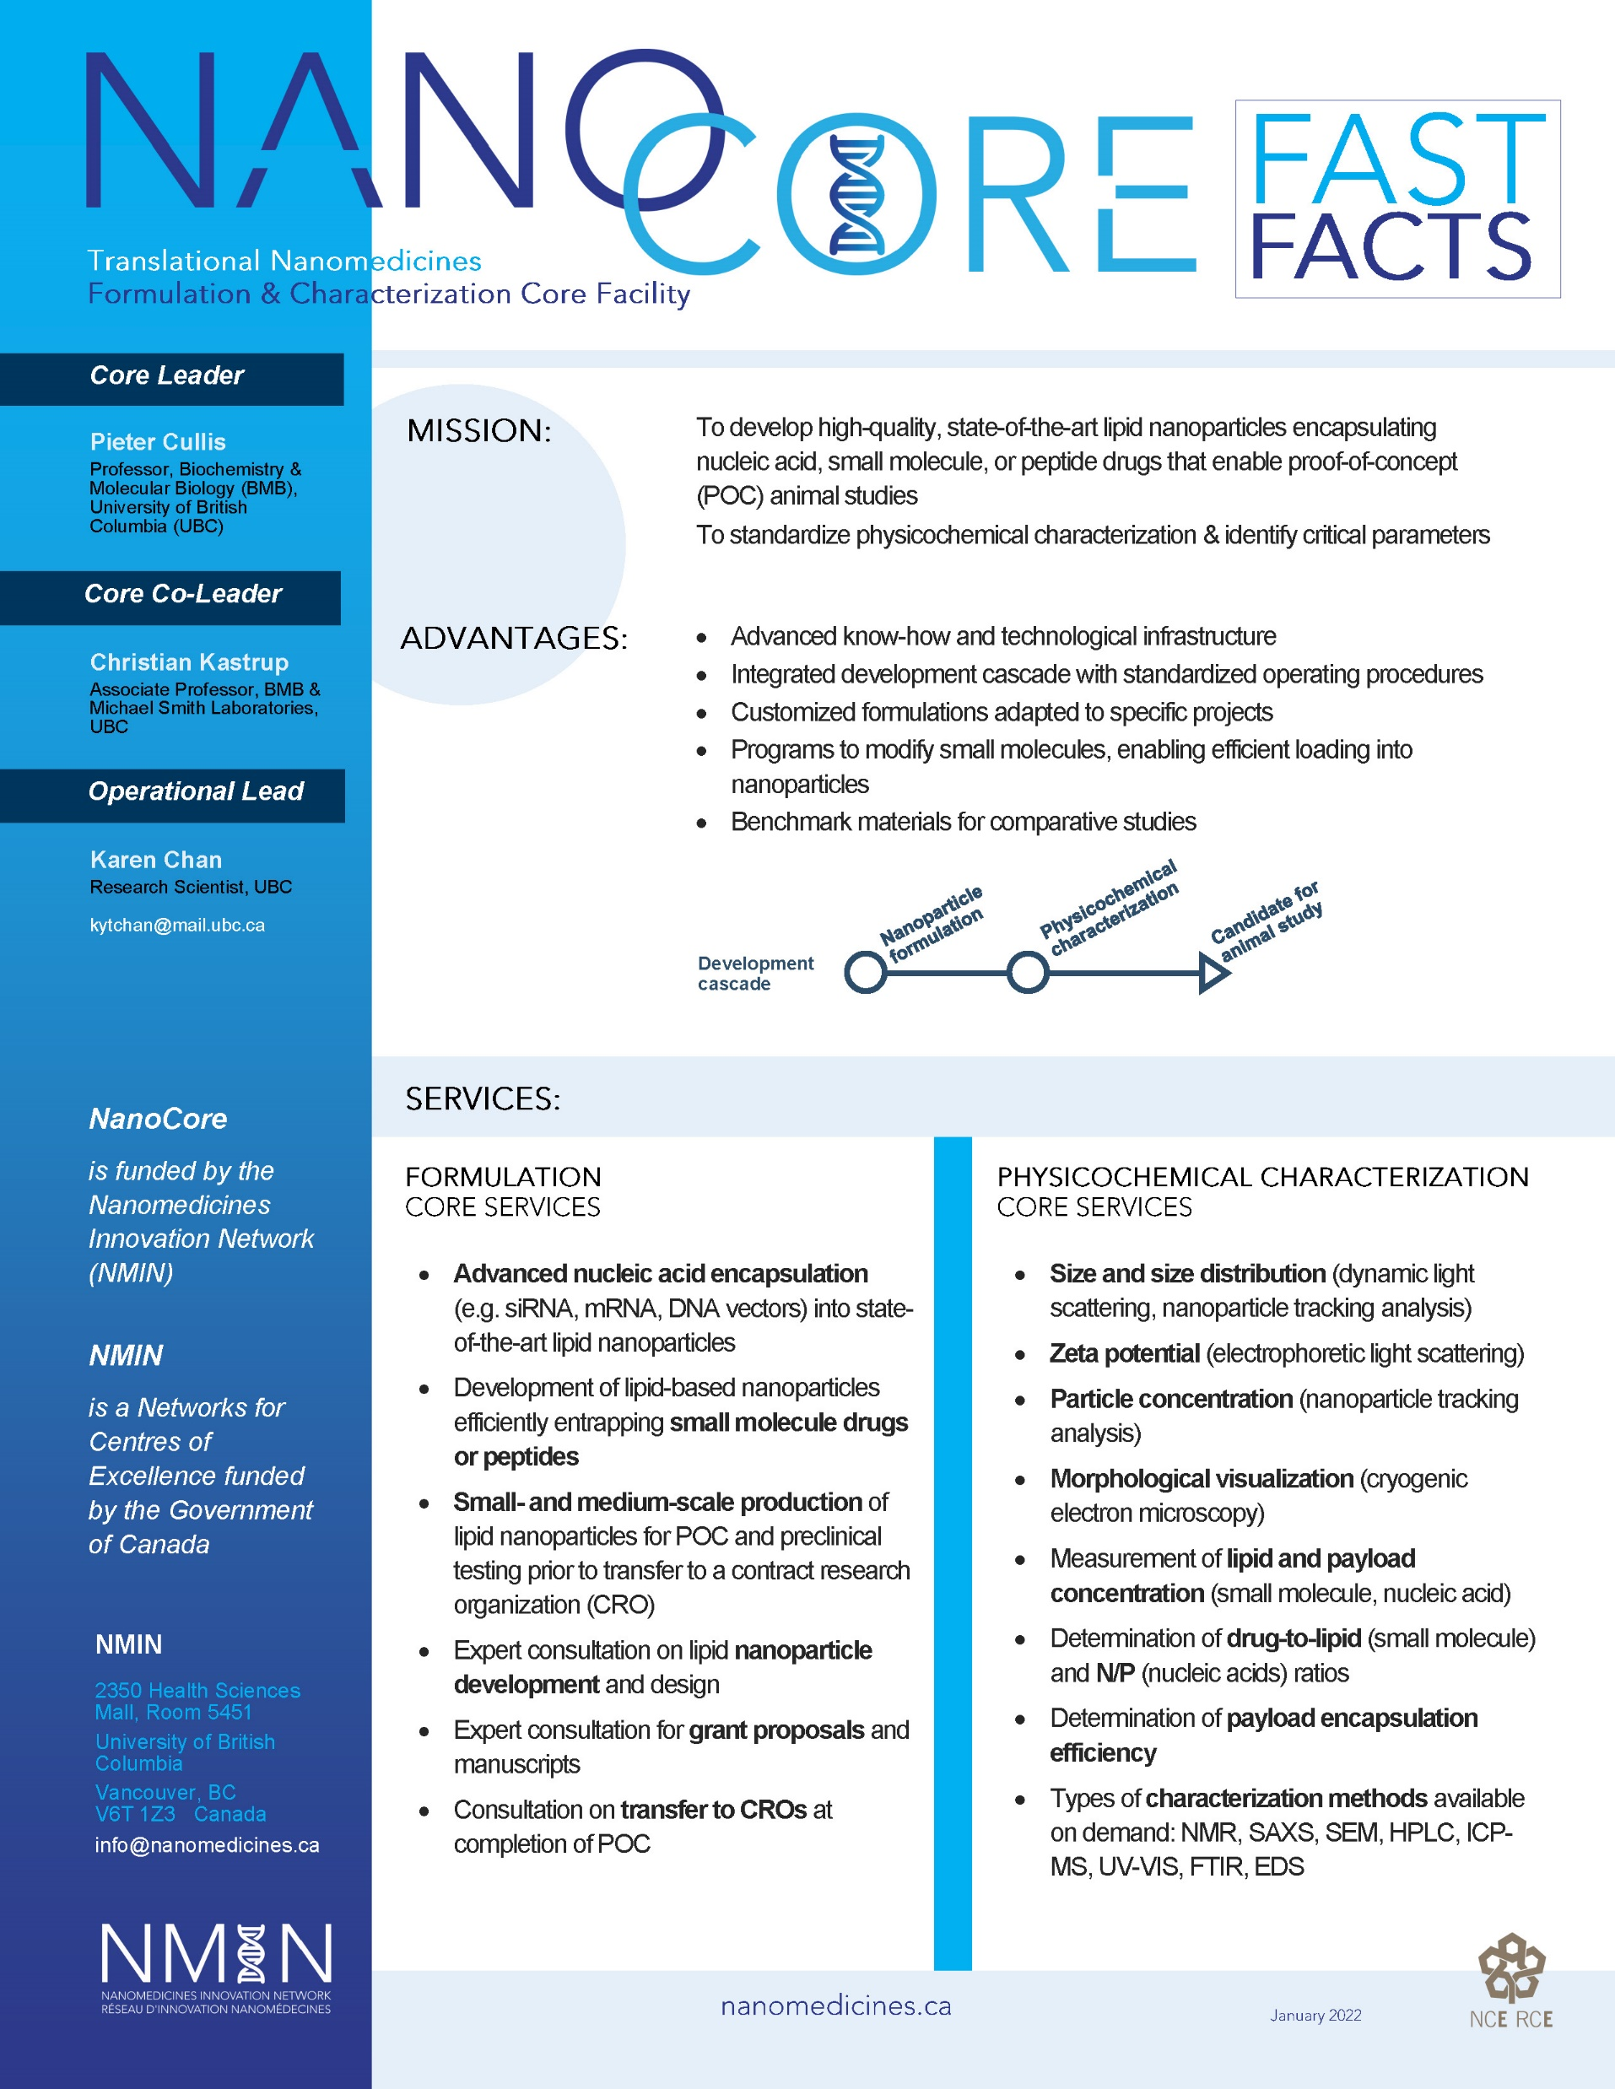
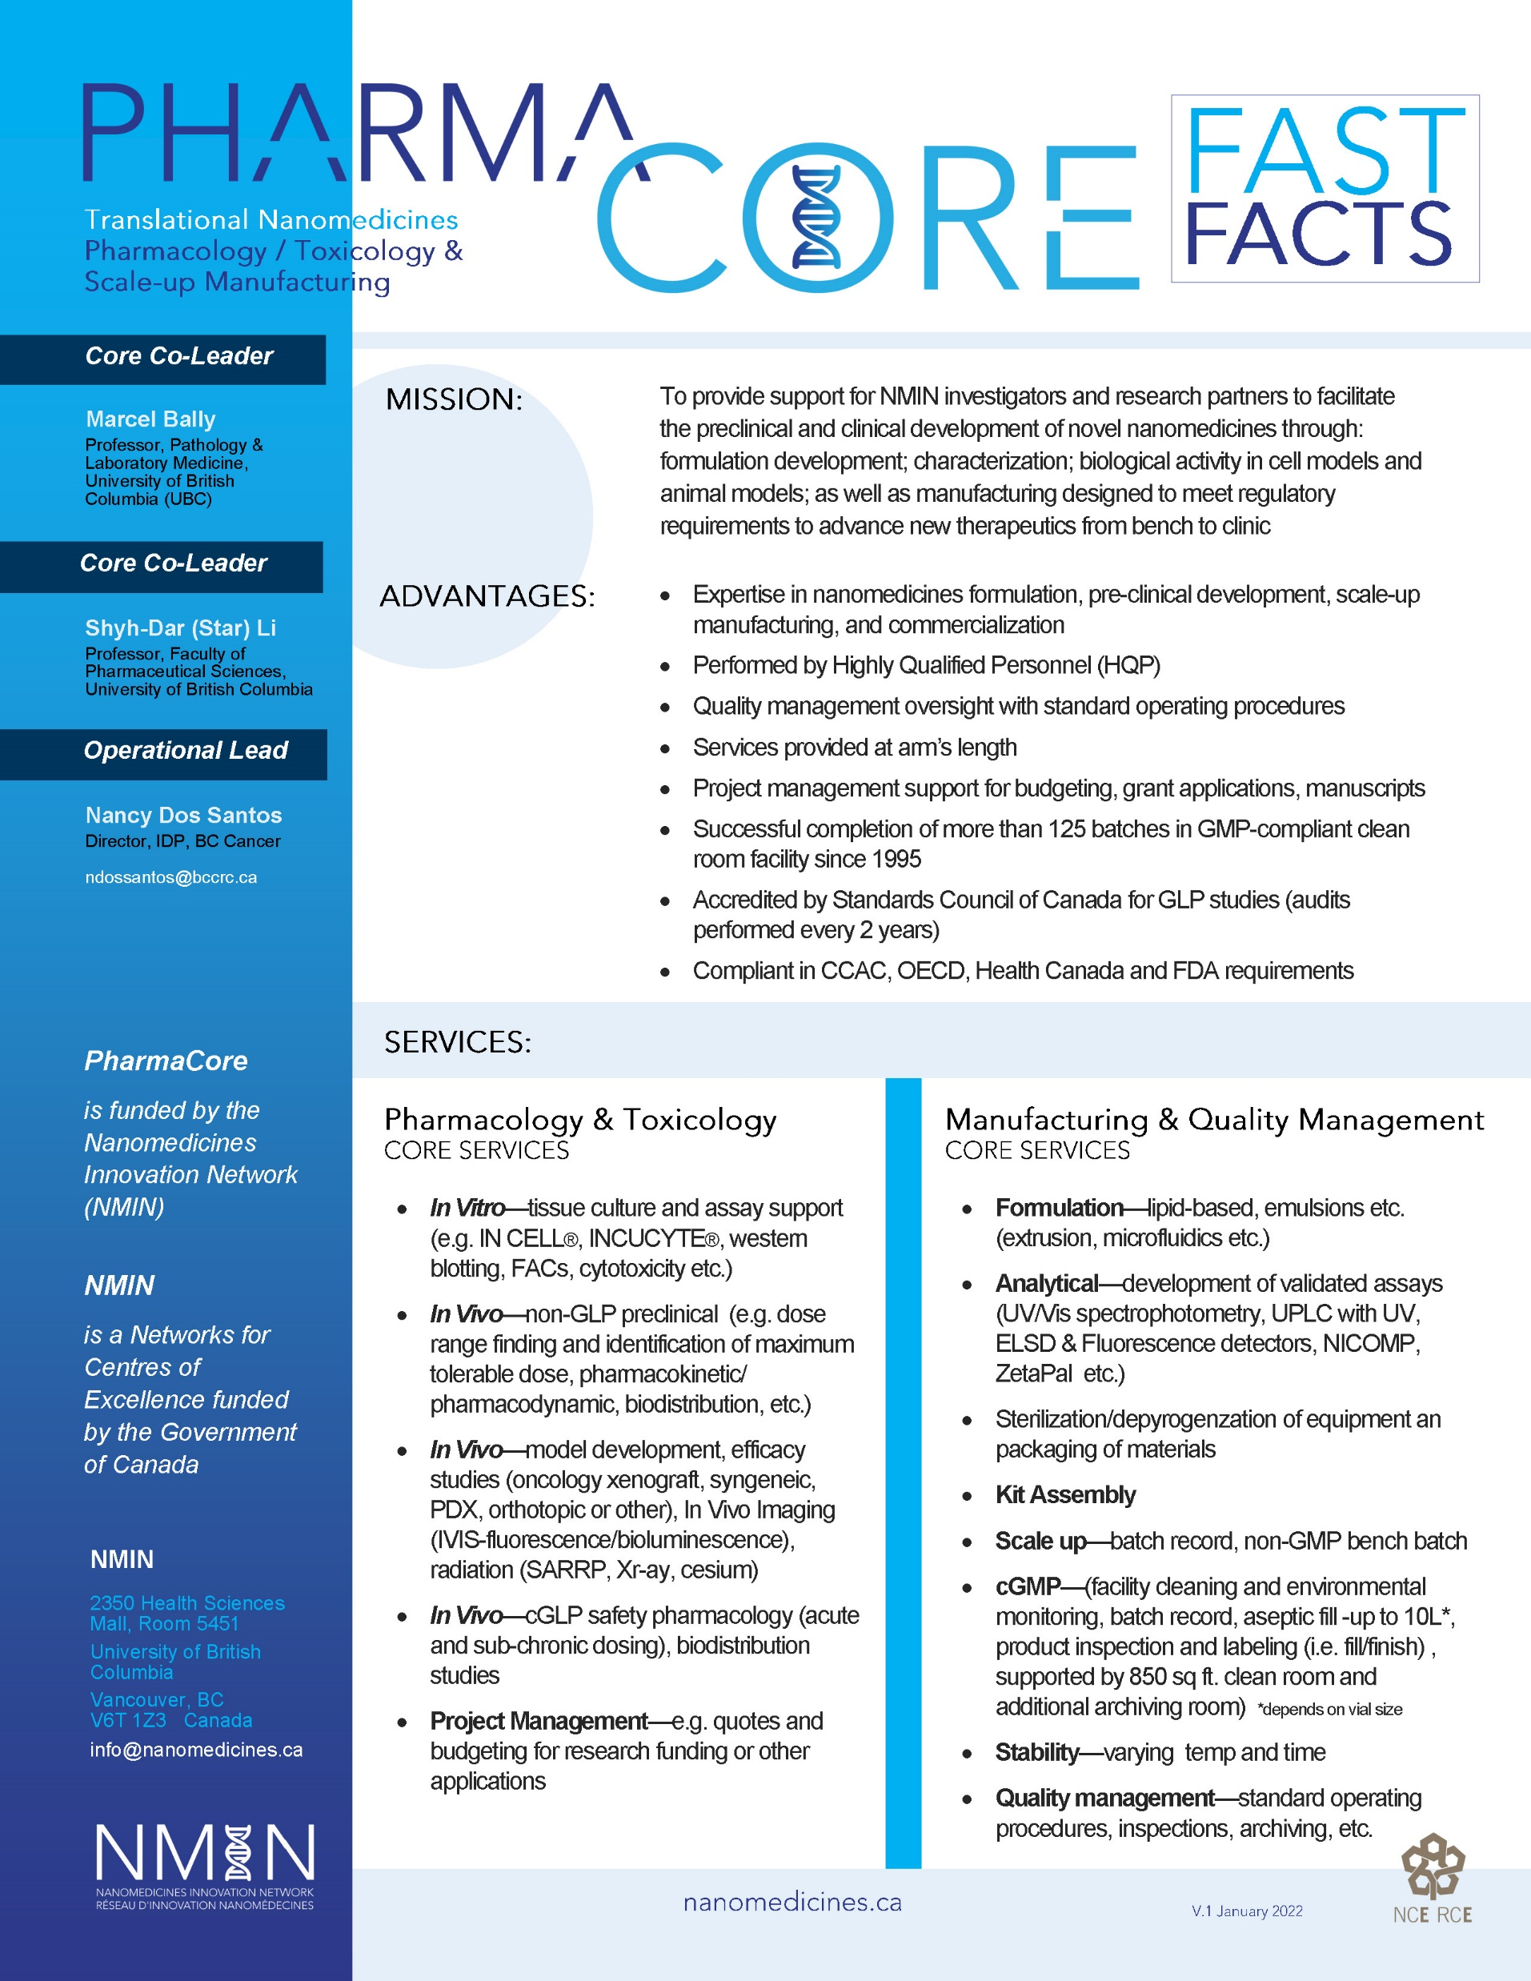
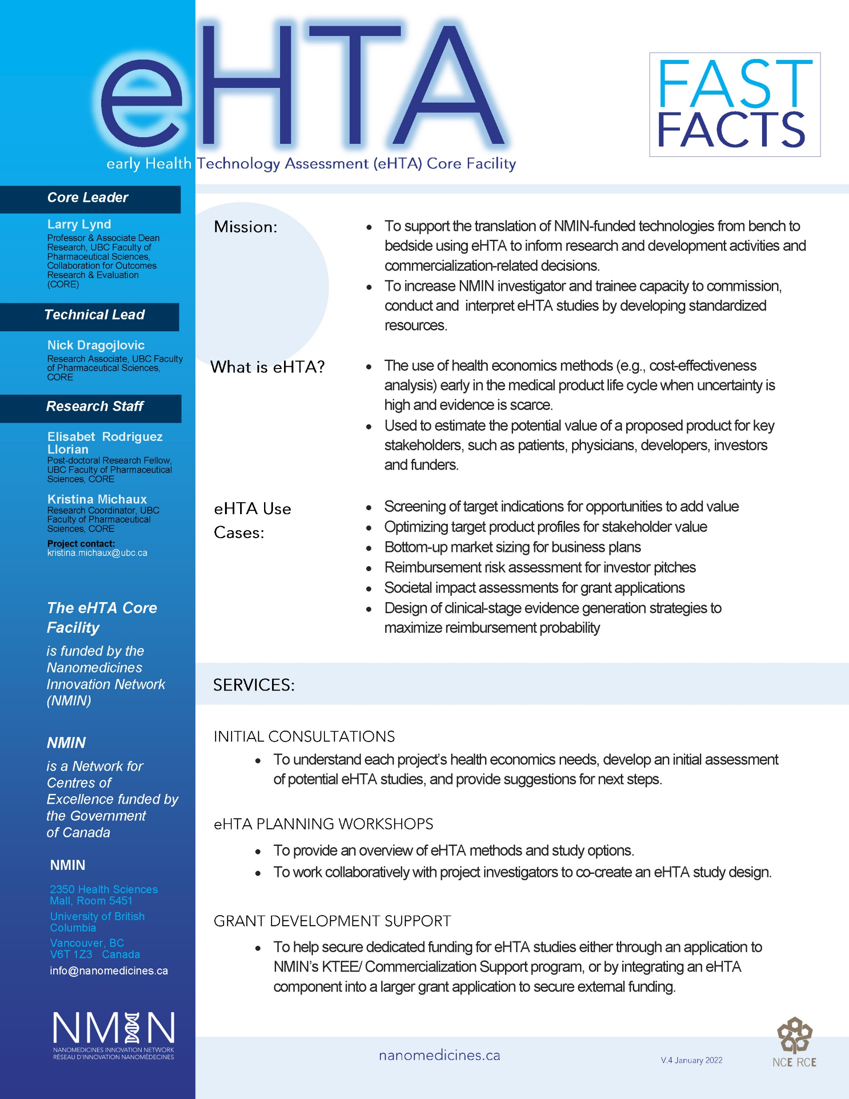
NMIN Legacy Initiatives: Core Facilities

Slide 12
Spin-off companies
(n=6)
NanoStar Pharmaceuticals
SeraGene
Project: Developing a Long-Acting Prophylactic Treatment for Hemophilia using siRNA Mediated Inhibition of Fibrinolysis | PI: Christian Kastrup
NorthMiRs
Project: Lipid Nanoparticle-mediated Immunotherapy for Pseudomyxoma Peritonei | PI: Star Li
Project: A platform to screen for upregulation of soluble calreticulin as a tool to develop nanomedicines targeting acute myeloid leukemia| PI: Gilbert Walker
Project: Site-specific laser-mediated gene therapy for corneal endothelial diseases | PI: Michel Meunier
Projects: Triggered release of anticancer drugs from LNP systems & GeneCure: Application of Lipid Nanoparticle Technology to Gene Therapies in a Variety of Tissues | PI: Pieter Cullis
Project: Automated Biofunctionalization of Lipid Nanoparticles for CAR T Cell Therapy | PI: Keith Pardee
Notes:
Table 1: NMIN Spin-off Companies, as at 12 July 2022
NanoVation Therapeutics
Sept 2020; BC
P. Cullis
Develops next-generation platform technologies utilizing lipid nanoparticles for the safe and efficient delivery of nucleic acids to a variety of tissues.
SeraGene
Feb 2022; BC
C. Kastrup
Harnesses nanomedicine technologies to develop the next generation of hematological therapeutics to treat coagulation disorders.
Vega BioImaging
Aug 2021; QC
M. Meunier
Provides novel immunolabeling which allows to bring quantitativity and multiplexing in cytopathology for a more accurate diagnostic. The immunolabelling is also compatible with standard H&E staining and allows for dual mode imaging in a simple switch.
Liberum Biotech
Mar 2021; ON
K. Pardee
Develops next-generation cell-free protein synthesis systems to enable rapid production of enzymes, therapeutics and lab reagents.
NanoStar Pharmaceuticals
June 2022; BC
S. Li
Develops innovative drug delivery technologies to enable novel therapies.
NorthMiRs
June 2022; ON
G. Walker
Targets to prepare an IND dossier to treat sepsis using miRNAs (and likely a prodrug) with LNP or related delivery.

Slide 13
IMPACT by the numbers
6 spin-off companies
8 IP + 5 patents filed + 3 invention disclosures
24 pre-clinical technology dossiers/Portfolio of Documents
25 partner/project agreements
25 jobs created
53 peer-reviewed publications 628 total publications
248 trainees engaged in research & capacity-building[all yrs]
Notes:
Active HQP – 191
Cumulative HQP – 248
(not sure which this is)

Slide 14
The Nanomedicines Innovation Network (NMIN)
NMIN’s HQP Program
2019-2022
By level
Awards granted
NMIN HQP 2022 = 168
8 PhD awards
7 Master’s awards
4 Postdoctoral awards
5 NMIN/Mitacs internships
14 Undergrad studentships
By gender
HQP research investments $237,000
2019-2022
19 HQP received Advanced Training Certification
31 HQP delivered Research Presentations
31 HQP meaningfully employed
155 HQP partook of NMIN learning opportunities

Slide 15
LEGACY STRATEGIES
Whole platform self-support/self-sustainability
Parachuting to a new funding program where the Network core/platform or individual constituent component parts are funded as discrete projects
Bridging to a new team/network where the core/platform becomes a “preferred service provider” to single or multiple new entities
Grafting on to a new organization’s operations by being absorbed/integrated into another organization’s core mandate

Slide 16
Thank you!
Presenter Name
Email address@nanomedicines.ca

